Slide 1
Data Management Project
Building a dataset for Football analysis

Slide 2
Business Understanding
We try to build a dataset in order to help to answer to the questions that a scouting team in football could have, giving insights from the data.
In particular, in the final dataset is possible to understand if there is a correllation between the performance of the football players and the physical and demographic characteristics, the championship and the role of each of them.

Slide 3
Data Acquisition
In order to achieve our goal the data are provided from three different sources:
Understat, offensive data (Goal, Assist, Key passes, xG, xA, …);
api-football, physical and demographic data (height, weight, age, …);
Fbref, defensive and passing data;
The downloaded data cover the seasons starting from 2017/2018 to 2020/2021 of the top 5 european championships: Premier League (Wales and England), Serie A (Italy), La Liga (Spain), Ligue 1 (France), Bundesliga (Germany).
From Understat and api-football we obtain 1 json file for a given league of a given season, for a total of 40 json file. From Fbref we obtain 2 json file for a given league of a given season (one for passing stats and the other one for defensive stats).

Slide 4
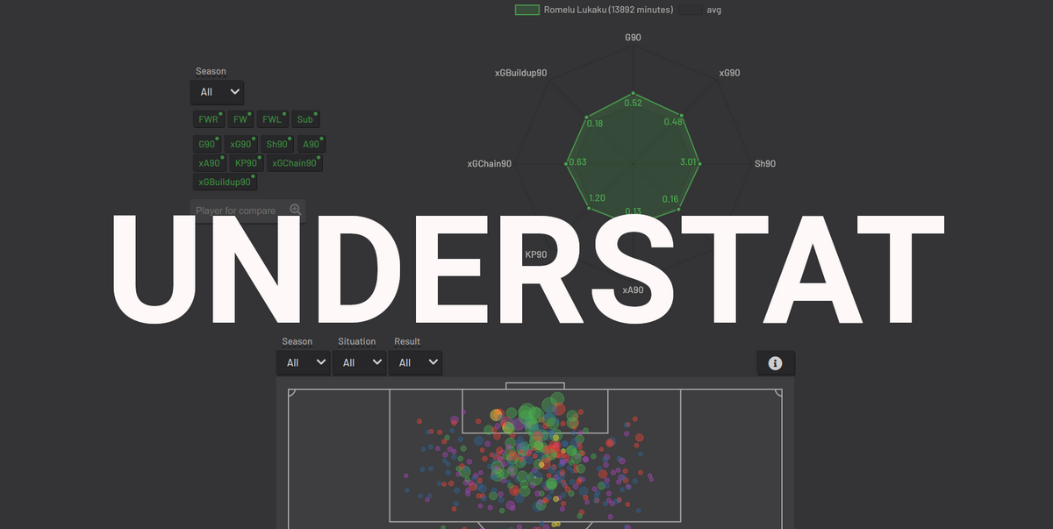
Data Acquisition
Understat
API is used as a data acquisition technique with the Python package understat
The function used is get_league_players: it receives in input an integer and a string, while in output it returns a list of dictionaries
All data of the players who played at least 15 games are kept
In conlusion 20 Json file are obtained (5 leagues, 4 seasons)

Slide 5
Data Cleaning
Understat
Some data cleaning operations are already carried out during the data acquisition phase:
Numeric data given in string format
Players who changed teams in the middle of the season, there is a duplicate value for the team field (the percentage of players is equal to 0,03%)
Options to deal with special characters
Special trick for apostrophe character

Slide 6

Data Acquisition
api-football
API is used as a data acquisition technique
In input the function receives 2 string: season and id league, in addition a third string is added indicating the page of reference
In output it returns the data of a given season/league across multiple pages
The return value is a dictionary of dictionaries and lists
With a first request the number of pages of each dictionary is obtained, with the others in order to download the data the focus is on the players dictionary inside the response list
In conclusion 20 Json file are obtained (5 leagues, 4 seasons)

Slide 7
Data Cleaning
api-football
Some data cleaning operations are already carried out during the data acquisition phase:
Numeric data given in string format like weight (kg) and height (cm)
Age field indicating the current age, but not the one during the given season, that will be obtained using the birth date field
Elimination of the fields of the dictionary that we are not interested in
Options to deal with special characters

Slide 8

Data Acquisition
Fbref
Main advantage: availability of modern stats and possibility to widen our dataset with advanced metrics
Disadvantages: no availability of a free API, the links does not have a fixed schema suitable for web scraping, data available starting from the 2017/2018 season
Web Scraping is used as a data acquisition technique, in order to download the data the url of the page which contains the table of interest is used
Data obtained: passing and defensive stats, selecting the metrics of greatest interest

Slide 9
Data Cleaning
Fbref
Some data cleaning operations are already carried out during the data acquisition phase:
Numeric data in string format
Normalization of the values in the column POS, only the first value is kept
Data are obtained in tabular format, but they are converted in json files in order to have a common structure. So 40 Json file are obtained, 2 for a given season /league (one for passing stats and the other one for defensive stats)

Slide 10

Data Modelling
80 json file.
We choose the document based as NoSQL model for our dataset.
As DBMS we choose MongoDB.
To interact with the dataset we use pymongo.

Slide 11
Data Modelling
1 collection for each given league and season.
1 document for each player.
Structure:
name, age, nationality, height, weight, team, position
general stats: games, time, red cards, yellow cards
offensive stats: goals, xG, xA, shots, key passes, npg, npxG, xGChain, xGBuildup
defensive stats: Tkl, TklW, Past, Press, Succ, Blocks, Int
passing stats: Cmp, Cmp%, 1 / 3, PPA, CrsPA, Prog

Slide 12
Data integration
During the download phase we make the same players have the same name in every dataset.
The field that make the aggregation possible is the name.
There are not schema conflicts.
Instance level conflict for the role of the players, we keep the values of Fbref.
At first we upload the file downloaded from api-football, then to these we add the offensive (Understat), defensive and passing stats (Fbref).

Slide 13
Data integration
We save the names of the players downloaded from Understat in a list of lists called football_players and the teams in a list of lists called players_teams.
Each sublist refrs to a given season of a given league.
We know the season and league each sublist refers thanks to the order of iteration:
Serie A second league for the order of iteration
2019 third season for the order of iteration
==> Serie A 2019 12th sublist
The j-th team of the i-th sublist of players_teams is the team of the j-th player of the i-th sublist of football_players.

Slide 14
Data integration
We change the name of each players downloaded from api-football and Fbref with the name of the right sublist of football_players, which has the maximum similarity. If no match is found the player is deleted.
Even the team is used in the calculation of similarity.
In this way in every dataset the names of the players are the ones coming from Understat.
This operation is implemented with a function called checkname.

Slide 15
Data integration - checkname
For each player downloaded from api-football we use checkname which receives in input:
the players_teams sublist of the right season and league
the football_players sublist of the right season and league
the full name of the player
the common name
the team
It considers every string in football_players, if the string consists of two names, it computes the similarity with the full name, otherwise with the common name.
For Fbref the checkname function receives in input only the common name.

Slide 16
Data integration - checkname
The similarity is computed with the SequenceMatcher criteria, the value ranges between 0 and 1. If the similarity is found even between the names of the teams
it is added a value of 0.2
It returns the string of football_players with which the maximum value of similarity occured. If the maximum value of similarity is less than 0.8 it returns an empty string.
The return value of checkname is assaigned to the name field of the player.

Slide 17
Data quality
Accuracy:
syntactic accuracy: name (Understat), role (Fbref), nationality (api-football) do not contain syntactic errors.
semantic accuracy: modern and specific performance stats for the three principal phases of the game.

Slide 18
Data quality
Completeness:
0.1% of the players do not have passing and defensive stats (these are the players included in the data downloaded from api-football but which are not present in those downloaded from Fbref).
Open world hypothesis, assuming Understat as a complete representation of the real world we get an average object completeness between the collections equal to 92%.

Slide 19
Data quality
Consistency:
even at the cost of losing some players we imposed that the names of the players should be those of Understat in every file downloaded.
We lose something in completeness in order to maximize the consistency.

Slide 20



What do you think about this work? What analysis would you do with the final dataset?
Let us know with a comment
Leave a like if you liked it
Lorenzo Bruni – lorenzobruni1999@gmail.com
Diego Bartoli Geijo – diego.bartoli.ts@gmail.com

